Slide 1
Digitizing Well Data
Instructional Walkthrough

Slide 2
Project Goal
The goal of this project is to digitize old data (from the early 1900s) on well information.
Very important to our work is discovering early wells that have depth and well water level measurements. This will allow us to compare early times (often before pumping of groundwater became extreme) to modern times (2010-present). Many old data exist but have not been digitized and therefore explored.
This is very exciting work! (And you will certainly be put in the acknowledgements section of whatever publication comes out this...hopefully!)

Slide 3
File Locations
Shared google drive folder here
"Digitizing Well Data"
Subfolder: "Your Name"
Subfolder: "Data to be Digitized" (contains Darton, 1905)
Subfolder: "Digitized Data" (contains google sheet of your work)

Slide 4
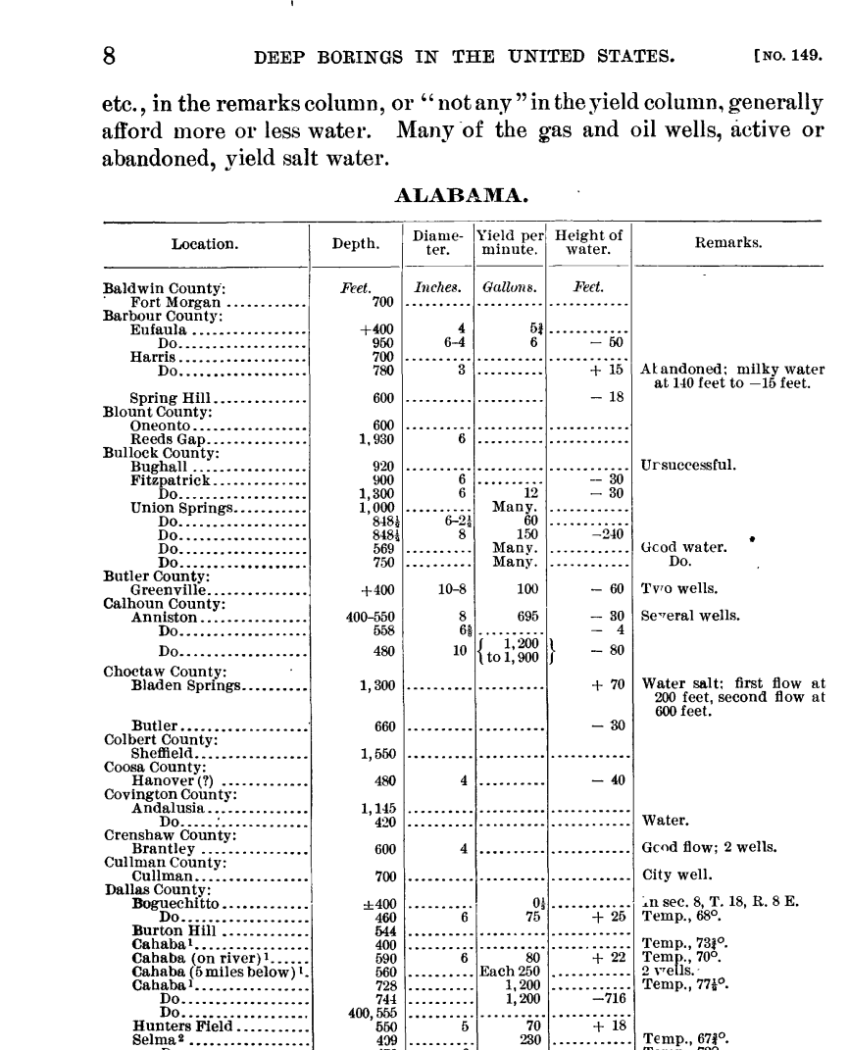
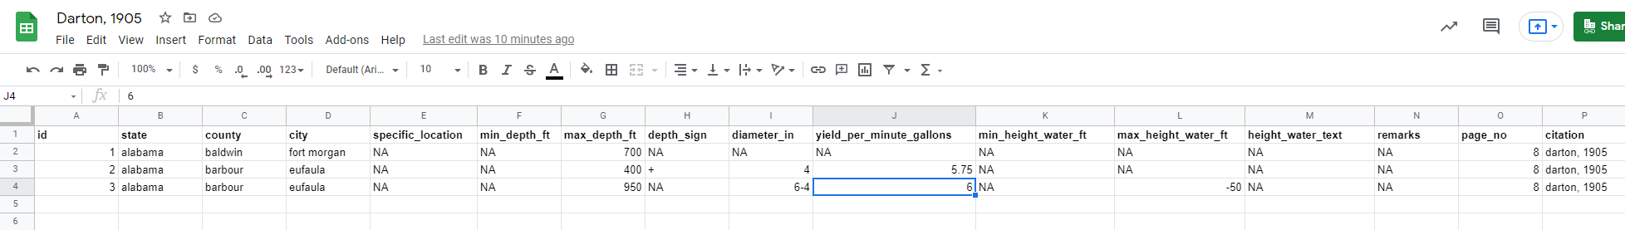
Step 1. First-pass digitization
Go from this
Transcribe almost word-by-word
To this!

Slide 5
Step 2. Double-check work (twice)
After you have done the first pass of digitization, please check your work two separate times
Up to you when to do this
Immediately after finishing
Wait a day, return to it
Accuracy is vitally important

Slide 6
Step 3. Send to Annette when each state is complete
Once you finish a full state, let me know and I will check the final work
It is important that the data are as accurate as possible, two sets of eyes to catch any errors will help
In the meantime, move onto a different state

Slide 7
Detailed how-tos
Column by column instructions
Other quirks...

Slide 8


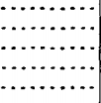
Keep data as tidy as possible
Eventually these data will go into R
To keep data as tidy as possible, please use all lower case (even locations)
Do not include characters (such as: ? ! or other) in text (if present, remove)
Note: you will keep "-" negative & positive signs, more info later
Replace any fractions with decimals (i.e. ½ in text becomes 0.5)
Any blank columns become "NA" (will say more about NA later)
Remove

Slide 9
Specifics: Number issues
All fractions must be replaced with decimal equivalent (example: 5 ½ becomes 5.5)

Slide 10
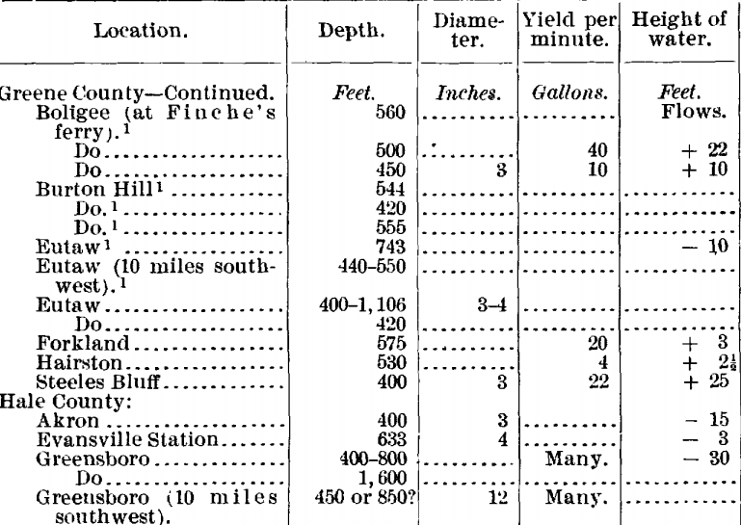
Specifics: NA
"...." is NA

Slide 11

Specifics: "Do"
"Do" means same as above
Example:
Do not write "Do", please write the original phrase/word
In this example, do not transcribe "Do" but replace with "union springs"
Union Springs
Union Springs
Union Springs
Union Springs
Union Springs

Slide 12
Specifics: Positive (+) and negative (-) numbers
Positive and negative numbers are very important, they indicate if a well is artesian or if the water level is below the land surface
This is truly information we are after! So very important
For column "height of water"
Positive numbers can be left normally (+3 = 3)
Negative numbers indicate with negative sign (-3 = -3)
For other columns, see further instructions…

Slide 13
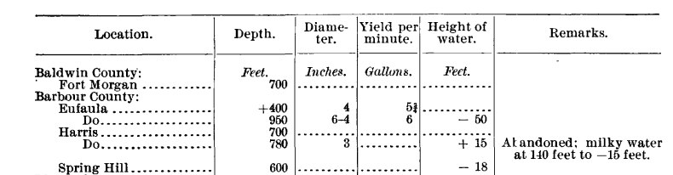
Columns
Add "id" column
Add "state" column
"Location" column becomes "county", "city", and "specific_location" columns
"Depth" column expanded
"Height of water" column expanded
Add "page_no"
Add "citation"
All other columns are the same

Slide 14
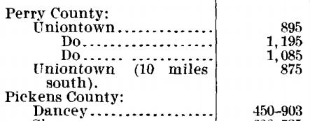
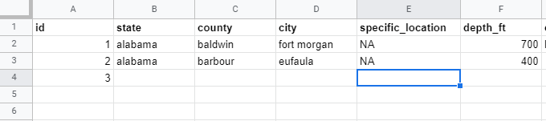
Specifics: Towns/cities with location instructions
For towns/cities that have specific locations added, extra column called "specific_location"
If none, NA

Slide 15
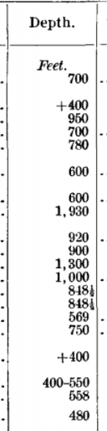
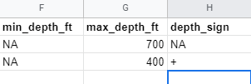
Columns: Well depths
"Depth" column becomes:
min_depth_ft
max_depth_ft
Depth_sign
If only one depth, put in "max_depth_ft" column
If positive or negative sign, put in "depth_sign" column
550 = max_depth_ft
400 = min_depth_ft

Slide 16
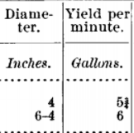
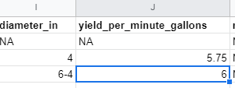

Columns: Diameter & Yield per minute
Write as is
"6-4" = "6-4"
5 ¾ = 5.75
Any text, write as is "Many" = "many", etc.

Slide 17
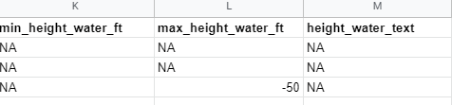
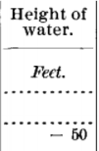
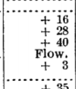
Columns: Height of water
"Height of water" column becomes:
"min_height_water_ft"
"max_height_water_ft"
"height_water_text"
If positive sign in front of number, can leave as is "+50" = "50"
If negative sign in front of number, type negative sign "-50" = "-50"
If text instead of number, or in addition to number, type in "height_water_text" column

Slide 18
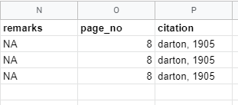
Columns: Remarks, Page Number, Citation
"Remarks" column write as is
Added columns "page_no" and "citation"
So we can keep track if we combine these data with other documents later

